Slide 1




Gambling III
Produced by Dr. Mario
UNC STOR 538

Slide 2

Money Management
Thought Experiment
Fact 1: UNC is Better Than Duke at Almost Everything
Fact 2: In All Circumstances, P(UNC > Duke) = 95%
Fact 3: You Have $10 Billion
Scenario: Competition of UNC vs Duke
Decision: How Much Should You Bet on UNC Winning?
$10
$100
$1,000
$100,000
All In and Ballin’
Goal: Choose an Amount For Long Term Gains
Not “How Much?”, But “What Percent?”

Slide 3
Money Management
J.L. Kelly, Jr.
Scientist at Bell Labs
Formulated the Kelly Criterion
Methodology Used by Mathematician Ed Thorp to Make Money on Roulette and Blackjack
Ideas Used in Financial Investment
Kelly Criterion = Optimal Percentage of Bankroll to Place on Bet in Order to Maximize Expected Growth of Wealth
Simplify Ideas to $1

Slide 4

Money Management
Situation: Start with $1.00
C = Starting Capital = 1
X = Bankroll After Bet
f = Fraction of Capital Placed on Bet (Unit)
p = Probability of Winning Bet
q = Probability of Losing Bet = 1-p
W = Profit Made Per $1 Bet When Won
L = Loss Per $1 Bet When Lost
Maximize For Kelly Criterion
$E\left[\log\left(X\right)\right]$

Slide 5
Money Management
Typically, for 50-50 Bet,
W = 100/110 = 0.91 = 91%
L =1
Suppose Money Line is Bears +220
W = 220/100 = 2.2 = 220%
L = 1
Suppose Money Line is Bears -220
W = 100/220 = 0.454 = 45.4%
L = 1

Slide 6
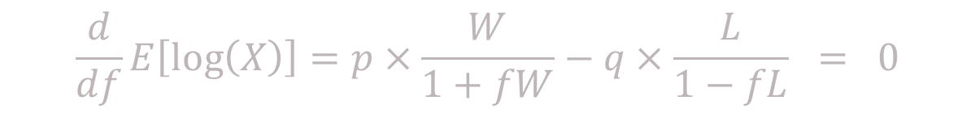

Money Management
Expected Value for Maximization
Taking the Derivative in Respect to
Solve Equation for
$$E\left[\log\left(X\right)\right]=p×\log\left(1+fW\right)+q×log⁡(1−fL)$$
$$f$$
$$\frac{d}{df}E\left[\log\left(X\right)\right]=p×\frac{W}{1+fW}−q×\frac{L}{1−fL} = 0$$
Set
$$f$$
Edge Favoring Bettor
$$f=\frac{pW−qL}{W×L}$$

Slide 7
Money Management
Restructuring
Example 1: Bet on a Spread With 60% Chance of Winning
$$f=\frac{p}{L}−\frac{q}{W}=\frac{p}{L}−\frac{1−p}{W}=\frac{p}{L}−\frac{1}{W}+\frac{p}{W}=−\frac{1}{W}+(\frac{1}{L}+\frac{1}{W})×p$$
Linear Model: y=a+bX
$$f=\frac{pW−qL}{W×L}=\frac{0.6×0.909−0.4×1}{0.909×1}=0.16=16\%$$

Slide 8
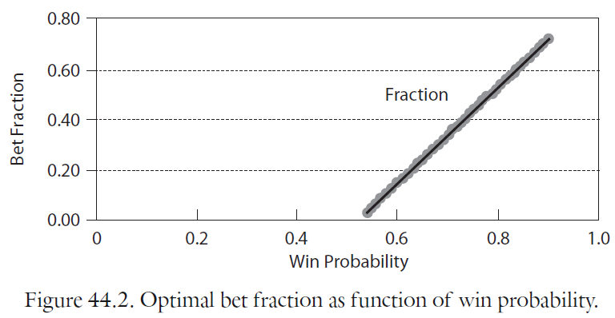


Money Management
$$f$$
$$p$$
Relationship Between and

Slide 9
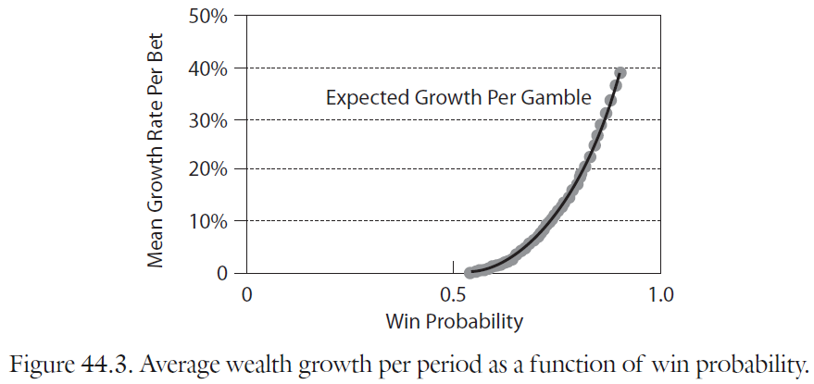


Money Management
$$E\left[\log\left(X\right)\right]$$
$$p$$
Relationship Between and

Slide 10
Money Management
Example 2: Bet on a Spread With 48% Chance of Winning
Example 3: Bet on a Spread With 95% Chance of Winning
$$f=\frac{pW−qL}{W×L}=\frac{0.48×0.909−0.52×1}{0.909×1}=−0.09=−9\%$$
Don’t Be an Idiot
$$f=\frac{pW−qL}{W×L}=\frac{0.95×0.909−0.05×1}{0.909×1}=0.89=89\%≠100\%$$
Don’t Be an Idiot

Slide 11
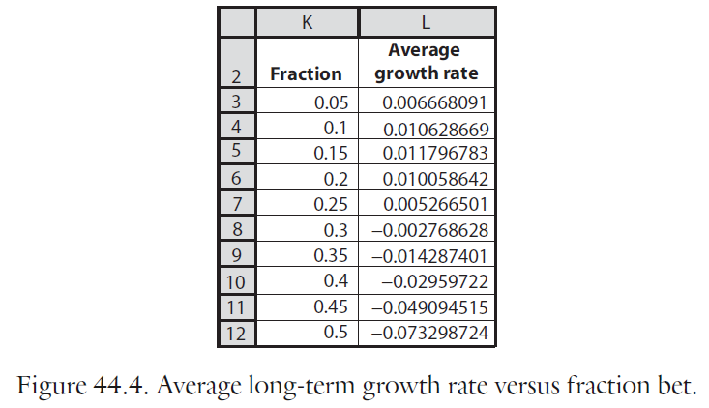

Money Management
$$E\left[\log\left(X\right)\right]=p×\log\left(1+fW\right)+q×log⁡(1−fL)$$
Recall:
Effect of Choosing Wrong
$$p$$

Slide 12

Final Inspiration
When I bet on horses,
I never lose. Why?
I bet on all the horses
-Tom Haverford

